Slide 1
Week 3b
COMPUTATIONAL MATHEMATICS

Slide 2
Outline
Continuous and Discrete Distribution
Inferrential Statistics

Slide 3
Reference
Robert Johansson. (2015). Numerical Python: A Practical Techniques Approach for Industry. Apress. Chapter 13: Statistics
You may also read:
https://anaconda.org/fe_gunawan/describing-data-with-statistics/notebook
You should read through the chapter and try the codes.

Slide 4
Let’s look back..
Slide 1b: scipy.stats

Slide 5
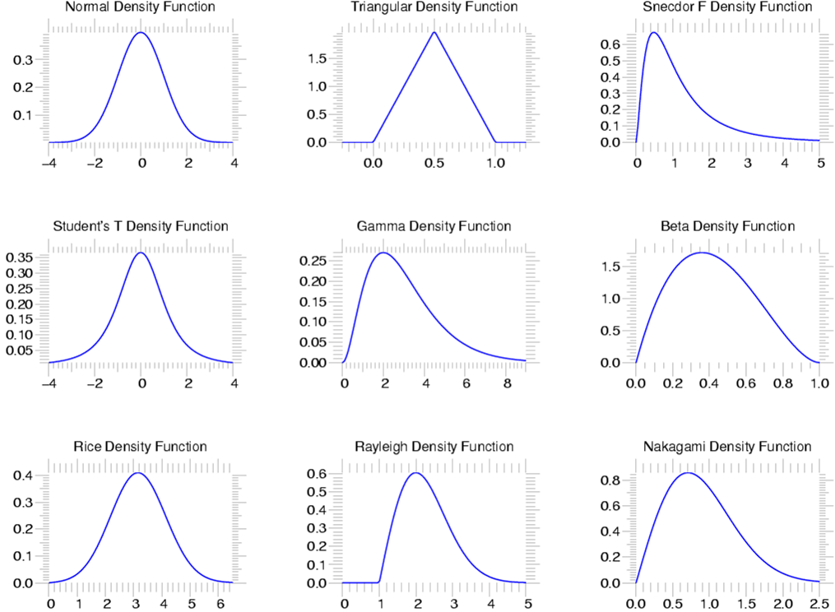
SciPy Statistics
scipy.stats --- CONTINUOUS DISTRIBUTIONS
over 80 continuous distributions!

Slide 6
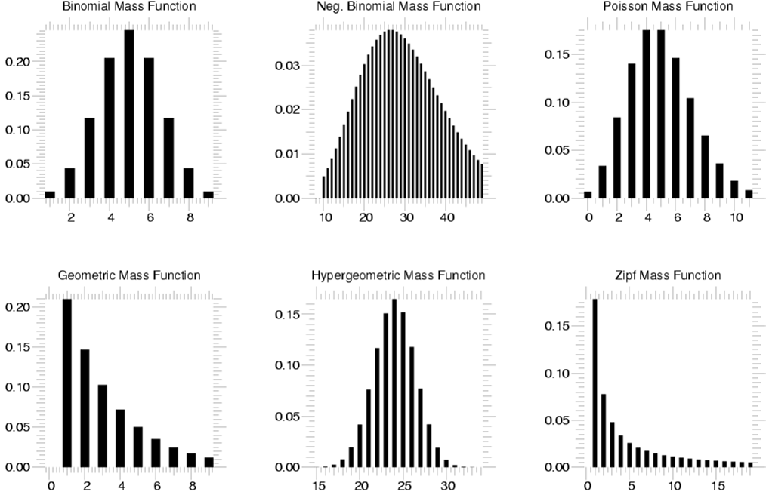
Statistics
scipy.stats --- Discrete Distributions
10 standard discrete distributions (plus any arbitrary finite random variates)

Slide 7
Descriptive Statistics
This is how to use it..
import scipy as sp
import numpy as np
data1=sp.randn(100) #generate 100 random number
print(sp.median(data1))
print(sp.stats.describe(data1))
print(sp.stats.skew(data1))

Slide 8
Create a normal distributed random variable
We specify the distribution mean=1.0 and standard deviation=0.5
> X = sp.stats.norm(1, 0.5)
X is an object that represents a random variable
To draw a random sample from the distribution, we use rvs (random variable sample)
> X.rvs(10)
the resulting random numbers indeed are distributed according to the corresponding probability distribution function (you can check its mean and standard deviation)

Slide 9
Random Variable
Random Variables can be either Discrete or Continuous:
Discrete Data can only take certain values (such as 1,2,3,4,5)
Continuous Data can take any value within a range (such as a person's height)

Slide 10
Continuous Distributions
A random variable is:
a quantity produced by a random process.
A continuous random variable is:
a random variable that has a real numerical value.
Each numerical outcome of a continuous random variable can be assigned a probability.

Slide 11
Continuous Distributions
The relationship between:
the events for a continuous random variable and
their probabilities is called:
Continuous probability distribution
is summarized by a Probability Density Function, or PDF for short.

Slide 12
Cumulative Distribution Function
The cumulative distribution function, CDF, or cumulant is a function derived from the probability density function for a continuous random variable.
It gives the probability of finding the random variable at a value less than or equal to a given cutoff.
So the CDF gives the amount of area underneath the PDF between two points.
It increases from zero (for very low values of xxx) to one (for very high values of xxx).

Slide 13
Continuous Probability Distributions
Some examples of continuous probability distributions are:
uniform distribution
normal distribution,
exponential distribution,
beta distribution, etc.

Slide 14

Uniform Distribution
The probability distribution function of the continuous uniform distribution is:

Slide 15
Uniform Distribution
Since any interval of numbers of equal width has an equal probability of being observed, the curve describing the distribution is a rectangle, with constant height across the interval and 0 height elsewhere.
That’s why we call it UNIFORM
Since the area under the curve must be equal to 1, the length of the interval determines the height of the curve.

Slide 16
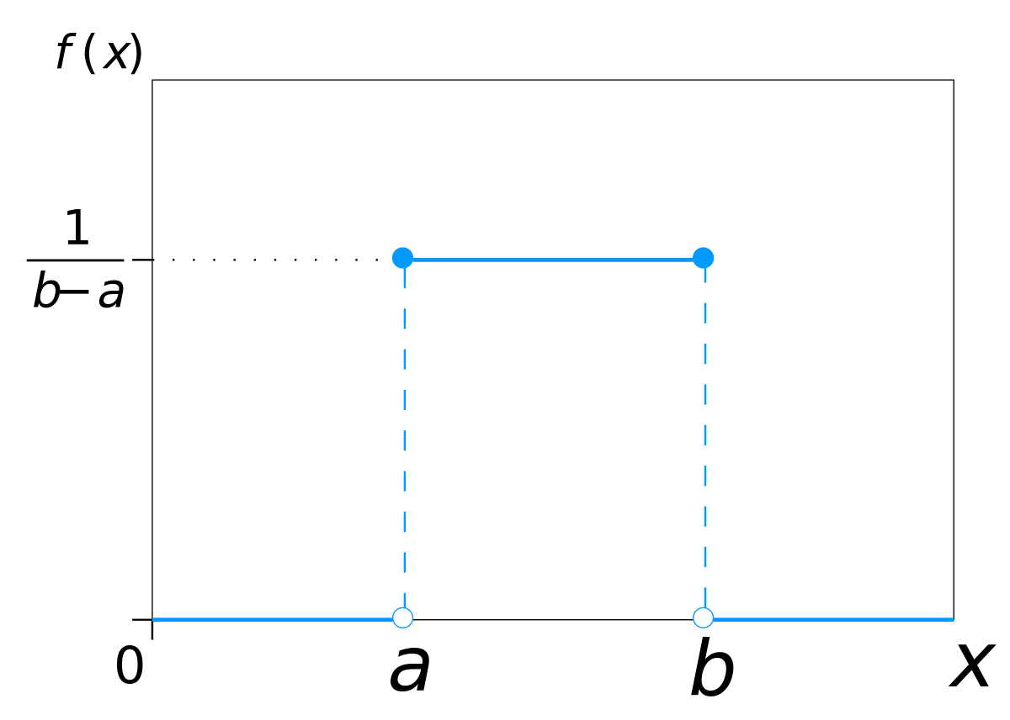
Uniform Distribution
The following figure shows a uniform distribution in interval (a, b).
The height is set to 1/(b−a).

Slide 17
Uniform Distribution
PDF
CDF

Slide 18
Uniform Distribution
Example:
The amount of time, in minutes, that a person must wait for a bus is uniformly distributed between zero and 15 minutes, inclusive.
What is the probability that a person waits fewer than 12.5 minutes?
On the average, how long must a person wait? Find the mean, μ, and the standard deviation, σ.
I’ll show you the manual process
You can try using python to solve this problem

Slide 19

Uniform Distribution
Let X = the number of minutes a person must wait for a bus.
a = 0 and b = 15.
Write the Probability Density Function.

Slide 20
Uniform Distribution
QUESTION: for 0 ≤x ≤ 15. Find P (x < 12.5)
The probability a person waits less than 12.5 minutes is 0.8333.

Slide 21
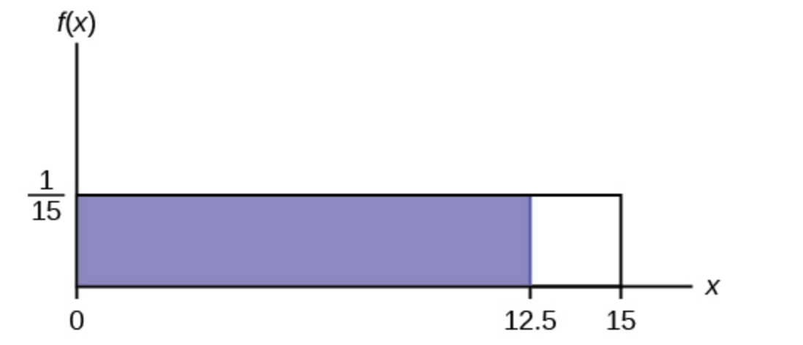
Uniform Distribution
Now let’s draw the graph:
Notes:
density histogram: is just a modified relative frequency histogram. A density histogram is defined so that:
the area of each rectangle equals the relative frequency of the corresponding class, and
the area of the entire histogram equals 1.

Slide 22
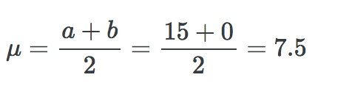
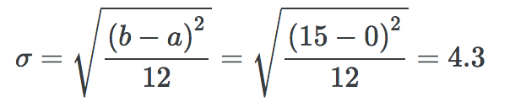
Uniform Distribution
Question b: On the average, how long must a person wait? Find the mean, μ, and the standard deviation, σ.

Slide 23

Uniform Distribution
Using Python is Super Easy
#to generate the distribution
X = stats.uniform(0,15)
#or alternatively X = stats.uniform(loc=0,scale=15)
#To find the probability that the variable has a value LESS than or equal to a NUMBER(12.5) you'd use CDF Cumulative Density Function
X.cdf(12.5)
# Alternatively we can just use: stats.uniform.cdf(12.5, 0, 15)
Notes:
CDF is the probability that X will take a value less than or equal to x

Slide 24
scipy.stats.uniform
The uniform function generates a uniform continuous variable between the specified interval via its loc and scale arguments.
scale
loc =
loc +scale =

Slide 25
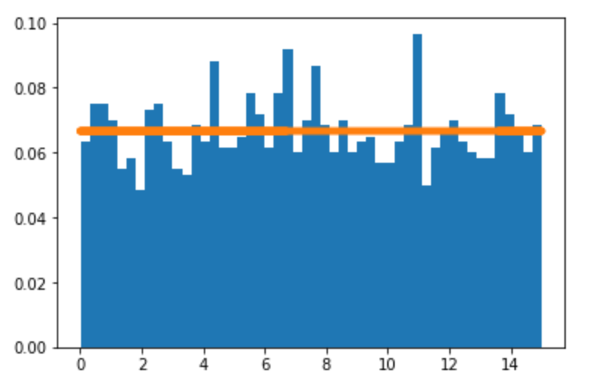
Uniform Distribution
#draw the samples
X_samples= X.rvs(2000)
plt.hist(X_samples, density=1, bins=50)
plt.plot(X_samples, X.pdf(X_samples), lw=5)
Notes:
https://courses.lumenlearning.com/odessa-introstats1-1/chapter/the-uniform-distribution/

Slide 26
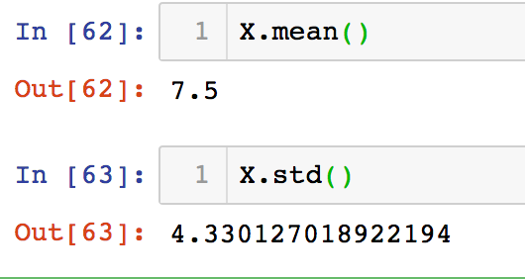
Uniform Distribution
For question b, even easier, just call standard descriptive statistics mean() and std()

Slide 27
Your Exercise
The total duration of baseball games in the major league in the 2011 season is uniformly distributed between 447 hours and 521 hours inclusive.
Find the mean and the standard deviation.
What is the probability that the duration of games for a team for the 2011 season is between 480 and 500 hours?
Take some random values from the given distribution and plot the histogram
Notes:
μ = 484, and σ = 21.36
P(480 < x < 500) = 0.2703

Slide 28
Normal Distribution
A normal distribution has a bell-shaped density curve described by its mean μ and standard deviation σ.
The density curve is symmetrical, centered about its mean, with its spread determined by its standard deviation showing that data near the mean are more frequent in occurrence than data far from the mean.

Slide 29
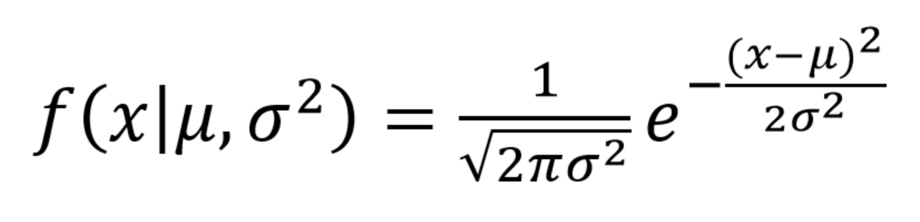
Normal Distribution
The probability distribution function of a normal density curve with mean μ and standard deviation σ at a given point x is given by:

Slide 30
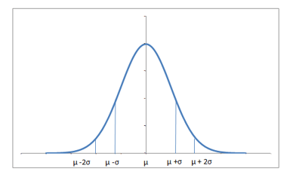

Normal Distribution
$$σ$$
Notes:
https://www.datacamp.com/community/tutorials/probability-distributions-python

Slide 31
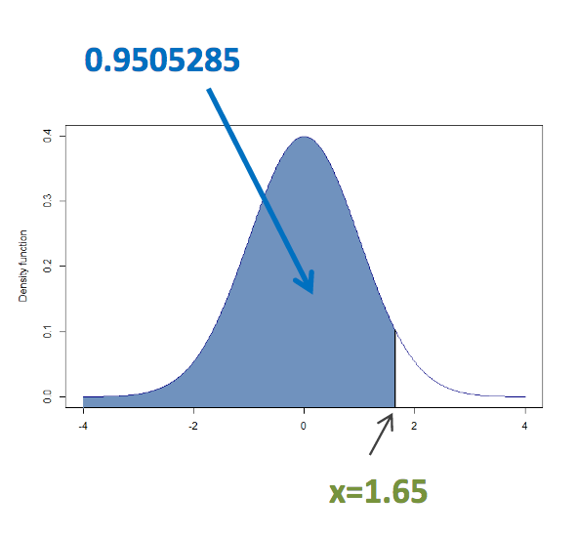
CDF of Normal Distribution
CDF of thestandard normal distribution (μ = 0 and σ = 1).
Probability of less than x = 1.65 is equal to 0.9505285
Python code:
stats.norm.cdf(1.65, loc = 0, scale = 1)

Slide 32
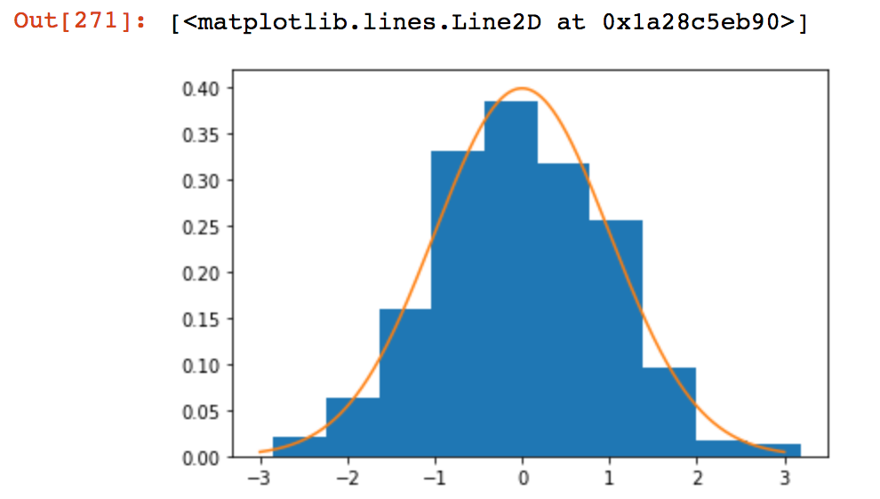
scipy.stats.norm
#create the normal distribution with mean=0, std=1
X = stats.norm(loc=0, scale=1)
#draw 500 samples
X_samples = X.rvs(500)
#plot the histogram
plt.hist(X_samples, density=1)
#plot the PDF
plt.plot(np.linspace(-3,3,1000),X.pdf(np.linspace(-3,3,1000)))

Slide 33
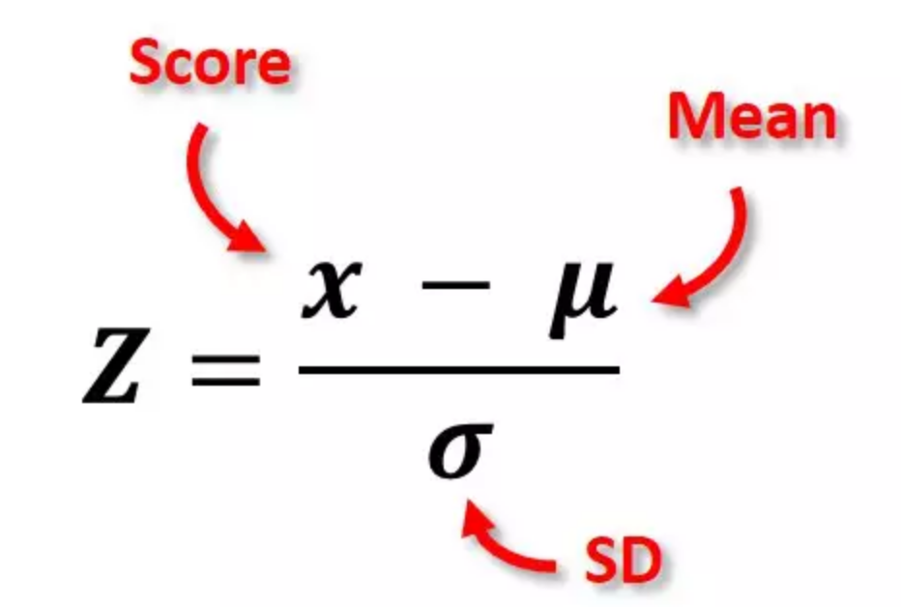
What is Z score
Z-scores are linearly transformed data values having a mean of zero and a standard deviation of 1.
To calculate Z-score, simply subtract the mean from each data point and divide the result by the standard deviation.

Slide 34
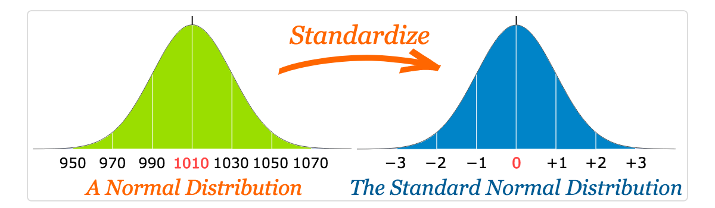
What is Z score

Slide 35
Z-Scores - Example
A group of 10 people took some test. My score was 5.24. So is that good or bad?
At this point, there's no way of telling because we don't know what people typically score on this test.
However, if my score of 5.24 corresponds to a z-score of 1.05, you'll know it was pretty good: it's roughly a standard deviation higher than the average (which is always zero for z-scores).
What we see here is that standardizing scores facilitates the interpretation of a single test score. Let's see how that works.

Slide 36
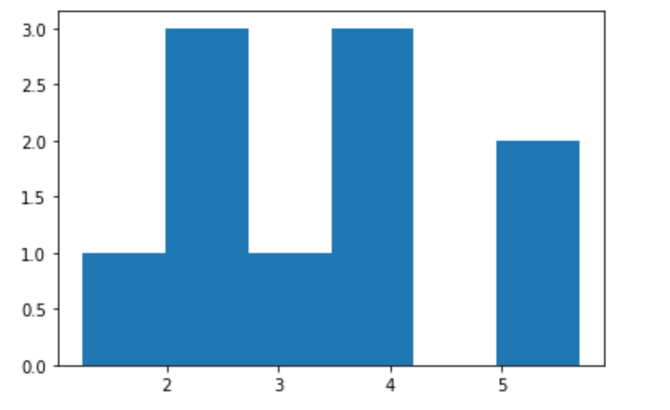
Z-Scores - Example
For example we have 10 test score as shown in var X below:
student_score=np.array([3.75605547,3.88584536,5.69095214,1.99733061,5.24978104,2.29331104,2.70503265,3.9237157,1.25510251,3.07190032])
plt.hist(student_score, bins=6)

Slide 37
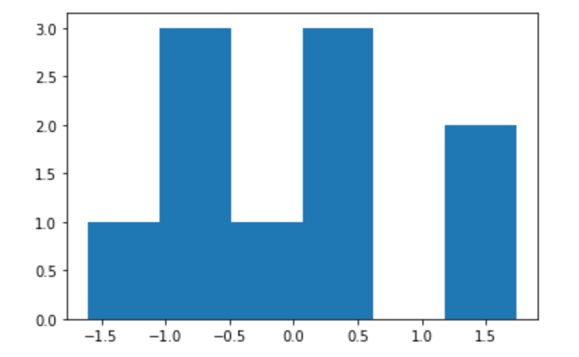
Z-Scores - Example
Transform them into standard normal distribution
stats.zscore(student_score)
plt.hist(stats.zscore(student_score), bins=6)

Slide 38
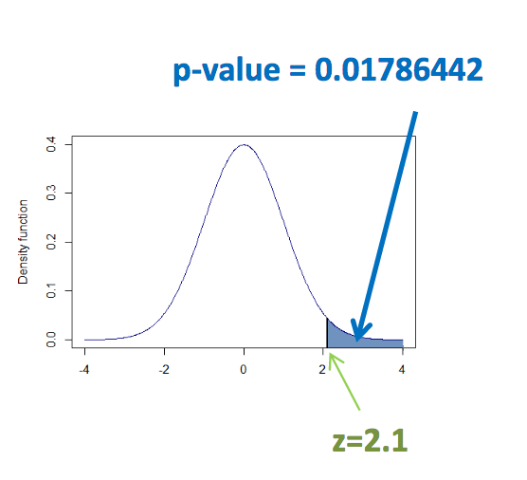
p-value
Calculation of the p-value for the standard normal distribution in a right tailed test.
The probability of more than z = 2.1 is equal to 0.01786442
Python code:
1-stats.norm.cdf(2.1)
stats.norm.sf(2.1)
Notes:
stats.norm.sf(x, loc=0, scale=1)
Survival function (also defined as 1 - cdf, but sf is sometimes more accurate).

Slide 39
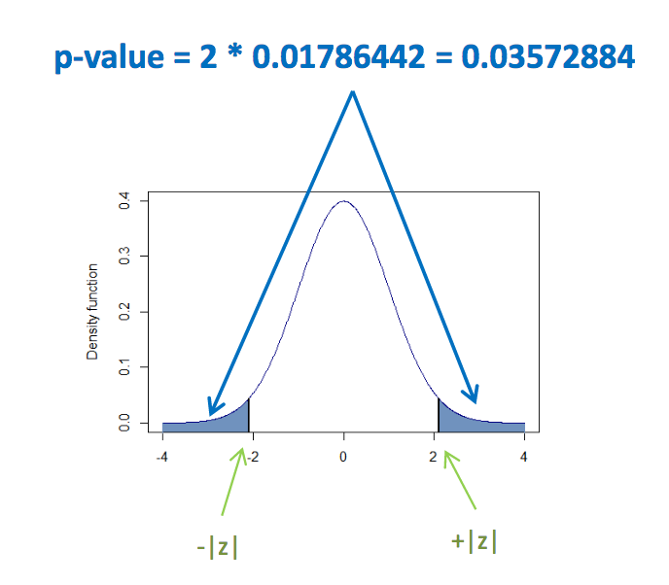
p-value
Calculation of the p-value for the standard normal distribution in a two-tailed test.
The probability of more than z = 2.1 in absolute value is equal to 0.03572884
Python code:
2 * (1 -stats.norm.cdf(2.1))

Slide 40
Hypothesis Testing
T- Test :- A t-test is a type of inferential statistic which is used to determine if there is a significant difference between the means of two groups which may be related in certain features.
the null hypothesis usually states that the population means of two random variables are no difference
If your sample size is greater than 30 use Z-Test

Slide 41
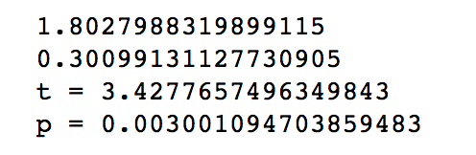
Hypothesis Testing
N = 10
#Gaussian distributed data with mean = 2 and var = 1
a = np.random.randn(N) + 2
print(a.mean())
#Gaussian distributed data with with mean = 0 and var = 1
b = np.random.randn(N)
print(b.mean())
t2, p2 = stats.ttest_ind(a,b)
print("t = " + str(t2))
print("p = " + str(p2))
We are interested in evaluating if the observed samples provide sufficient evidence for that the two
population means are not equal (rejecting the null hypothesis)
Output:
Here the p-value is about 0.03, which is small enough to support rejecting the null hypothesis that the two means are equal.
In this example the two population means are indeed different
*p-value < 0.05 shows that we can reject null hypothesis

Slide 42
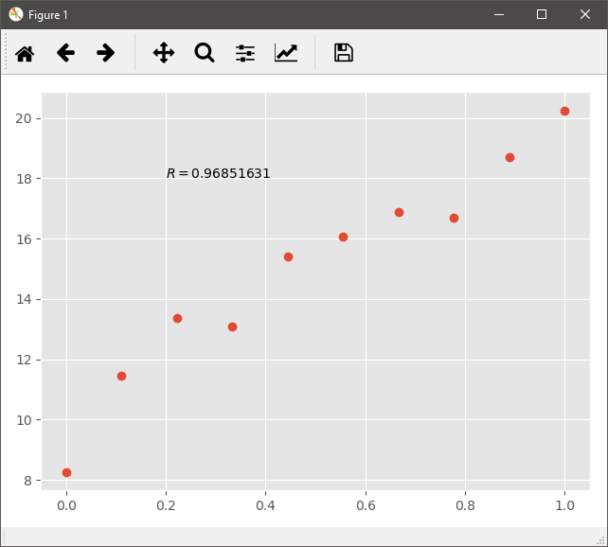
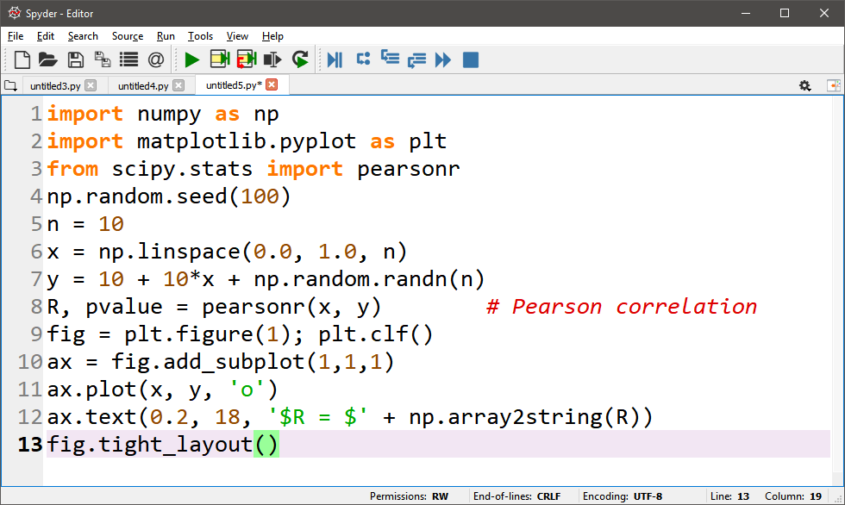
Pearson’s Correlation Coefficient
Codes
Results

Slide 43
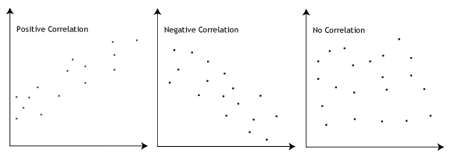
Pearson’s Correlation Coefficient
The stronger the association of the two variables, the closer the Pearson correlation coefficient, r, will be to either +1 or -1 depending on whether the relationship is positive or negative, respectively.

Slide 44
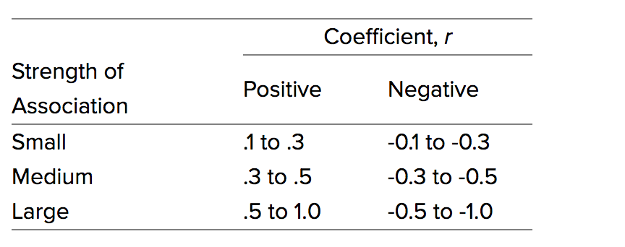
Pearson’s Correlation Coefficient

Slide 45
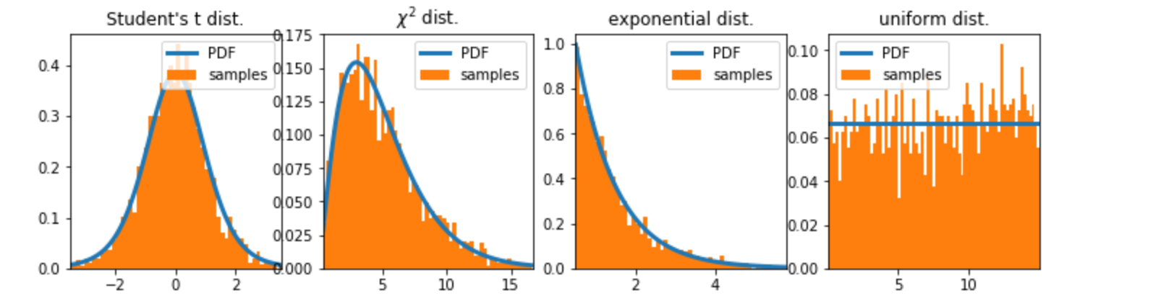
Your Exercise: 1
Create a program to display the histogram of population from four type of continuous distribution:
Normal Distribution, chi-squared distribution, Exponential distribution, Uniform distribution

Slide 46
Your Exercise: 2
Try to create your random variable from the given distributions, and calculate the PMF or PDF of specific X value, also you can calculate the CDF.
Discrete Random Variables
Binomial, Poisson, Geometric
Continuous Random Variables
Normal, Exponential, Beta

Slide 47
Your Exercise: 3
Open the file: brainsize.csv
Examine whether the mean VIQ in the male and female populations were different or not.
Examine whether both VIQ in the male and female populations are correlated or not.

Slide 48
Link to DATASET
http://bit.ly/dataset_compmath

